Slide 1
Assignment on Carry4 primitive
Our progress so far on Carry4 primitive assignment
26-09-2019
TIFR-FCRIT

Slide 2
The carry4 primitive has the following pins-
Port | Direction | Width | Function
O | Output | 4 | Carry chain XOR general data out
CO | Output | 4 | Carry-out of each stage of the carry chain
DI | Input | 4 | Carry-MUX data input
S | Input | 4 | Carry-MUX select line
CYINIT | Input | 1 | Carry-in initialization input
CI | Input | 1 | Carry cascade input
26-09-2019
TIFR-FCRIT

Slide 3
Our solution-
We cascaded 2 carry4 primitives.
Our main motive is to introduce a signal in the first carry4 primitive which then travels through all the MUXs present in both the carry4 primitives and is received on the other side on the CO[3] pin of the second carry4.
Both the carry4 primitives were given 1111 as input to the S pins and 0000 as input to the DI pins.
The input signal was introduced in the circuit from the CYINIT pin of the first carry4 primitive.
The CO[3] output pin of the first carry4 primitive was given as CYINIT input to the second carry4 primitive.
26-09-2019
TIFR-FCRIT

Slide 4
Working-
Whenever the input signal goes high, the CO[3] output pin of the first carry4 primitive also becomes high.
1111 + 0000 + 1 = 1 0000
This signal is provided as input to the second carry4 primitive.
The input signal travels along the cascaded carry4 primitives in such a manner.
26-09-2019
TIFR-FCRIT

Slide 5
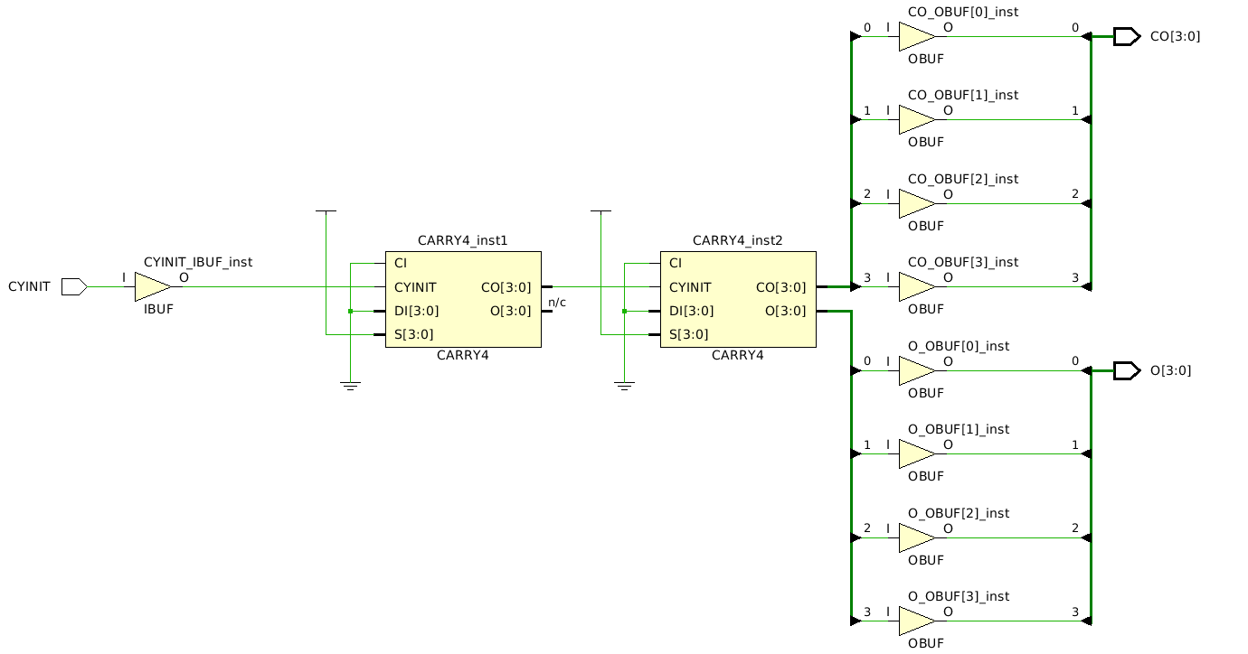
RTL Diagram-
26-09-2019
TIFR-FCRIT

